Slide 1
Test Evidence for Greenfield Local Hub (GLH)
Summer-Mae Wall
LL-000023418
Occupational Specialism
1.

Slide 2
Version 1 Tests
Planned development:
1.1 Back-end Database
1.2 User Registration
1.3 User Login
1.4 User Logout
2.

Slide 3
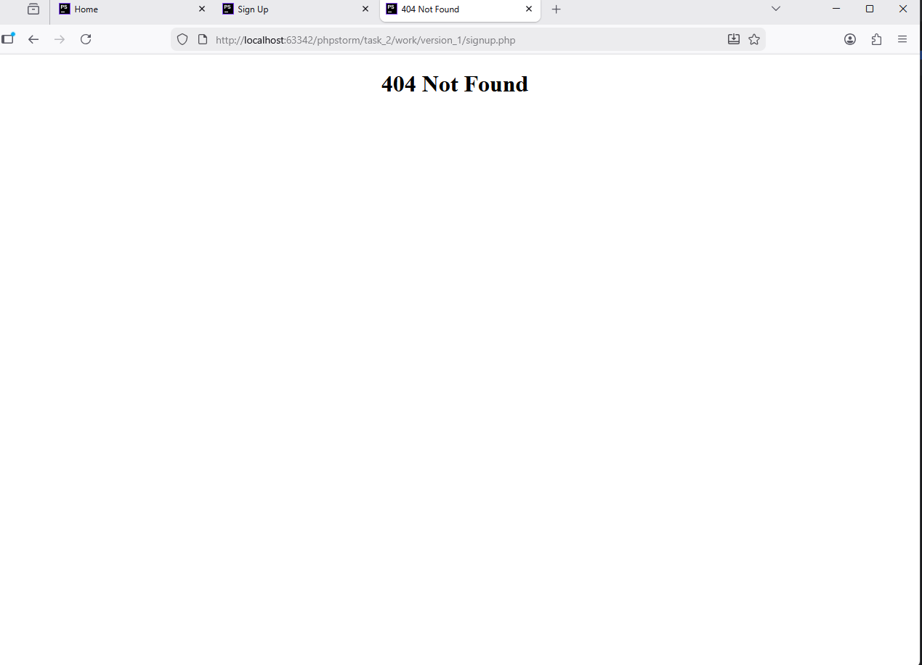
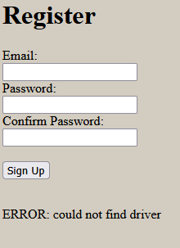
Test no. 1.1 Register Test
Test data:
email: emma.wilson@testmail.local
password: TestPass!2024
Tests resulted in a 404 error, this could mean
Multiple issues have occurred. After fixing file
Path names. Test was conducted again resulting in an error
displaying “ERROR: could not find driver”. This indicates an issue with
The PDO connection to the database.
3.

Slide 4


Test no. 1.1 Register Test
During this test, a technical error was found. Laragon (database) had some errors which had to resolved by my tutor (the issue was techincal, allowing assistance). There was a missing file in the laragon version (php.ini) which prevented the code from running. After the fix the code ran as intented. Redirecting the user to the login page.
My tutor had to submit to my registration page to ensure that the system did not come back with the error again.
Due to my tutor not knowing my planned test data, he used his own as follows below:
Email: test@test.com
Password: test
The system worked as intended with the password being hashed for security and the system including a sign-up date.
4.

Slide 5
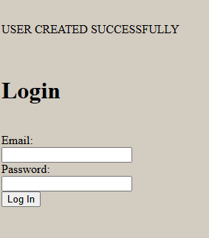
Test no. 1.1 Register Test
After the techincal issue was resolved, I did the intended test again with the correct test data (see page 3).
On submit, the system redirected the user to the login page to login to the system with a message displayed to the user saying “ACCOUNT CREATED SUCCESSFULLY”. This tells the user the account has been created. After checking the database, the test was displayed there as well with the password hashed and with the correct sign up date as intended.
5.

Slide 6
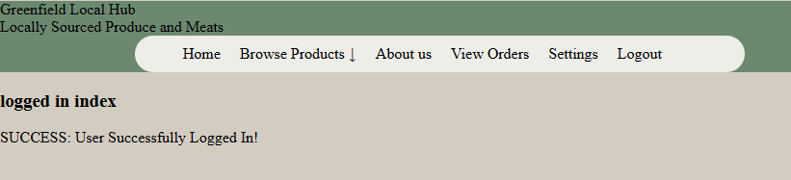
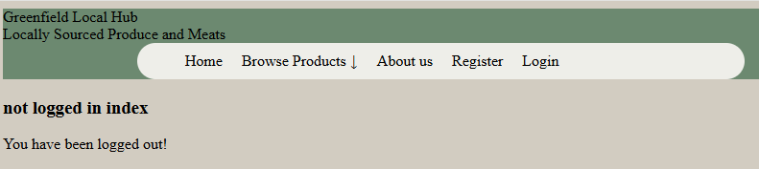
Test no. 1.2 Logout Test
Test data:
email: emma.wilson@testmail.local
password: TestPass!2024
Test resulted in user successfully being logged out and sent back to the index page with a message displaying the action. The navigation bar was also successfully updated to not being logged in as intended.
6.

Slide 7
Version 2 Tests
Planned development:
2.1 Audit System
2.2 Product Display
2.3 Basket
2.4 Checkout
2.5 View Orders
7.

Slide 8
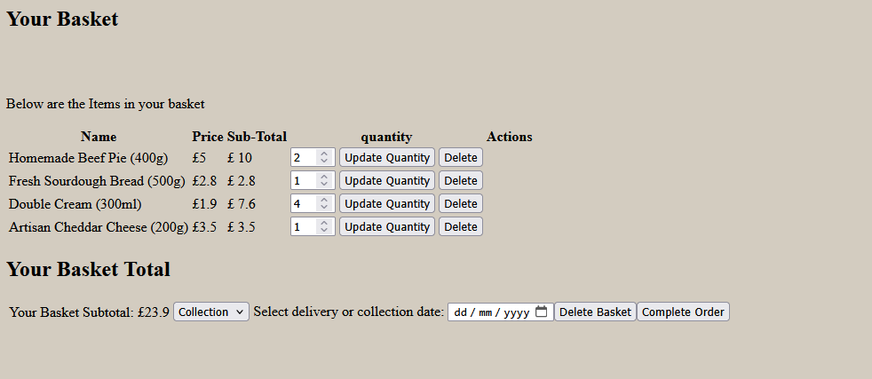
Test no. 2.1 Basket Test
After an item is added in the basket, it is successfully added to the basket, where a user can change the quantity or delete an item.
After a couple tries and some editing, this error message appeared on basket.php. To fix it, all that had to be done was create a basket if one didn’t already exist. The system had an issue where if you tried to click on the basket before adding an item, it wouldn’t work. This issue has now been resolved.
8.

Slide 9
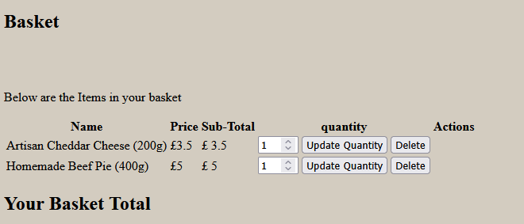

Test no. 2.2 Order Test
When testing I ran into an issue, When a user would place an order, the order id and product ids would flip. The product id would be where the order id should be and the order id would be where the product id should be.
This is a serious problem as it assigns products to incorrect orders and changes what product a user has ordered.
After investigating the issue, I discovered that it was caused by the orderid and itemid (productid) being flipped whilst executing the insert statement. (see page 10)
Orders table:
Basket table:
9.

Slide 10
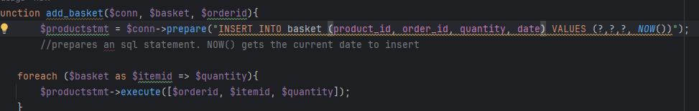

Test no. 2.2 Order Test
After the order and item id were flipped with the item id first, the issue was resolved and the data was implemented as intended after retesting.
Orders table:
Basket table:
10.

Slide 11
Version 3 Tests
Planned development:
3.1 View, Alter and Delete Orders
3.2 Loyalty Scheme
3.3 Stock Management
3.4 System testing
11.

Slide 12
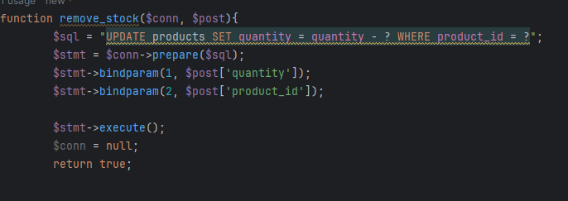
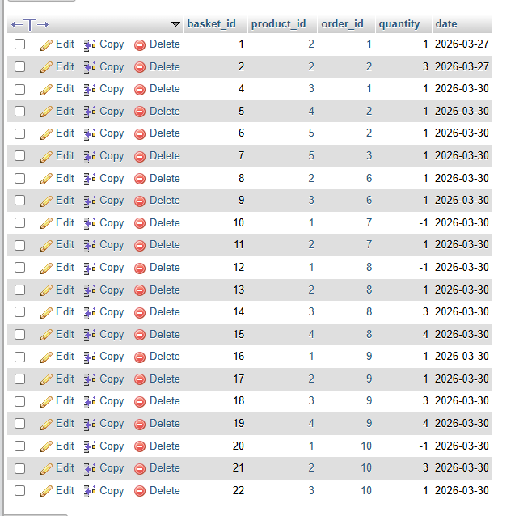
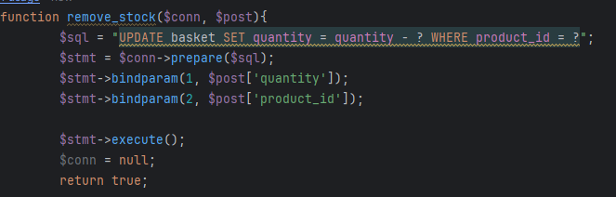
Test no. 3.1 Remove stock Test
Whilst I was testing my remove_stock function, I had accidentally set the table to basket instead of products. This resulted in the quantities of all products in the basket with the product_id of 1 to have their quantities altered.
This proves the importance of test data and testing the system before you release it for public use. As if this issue occurred in a live system, a large amount of customer order data would have been destroyed
12.

Slide 13
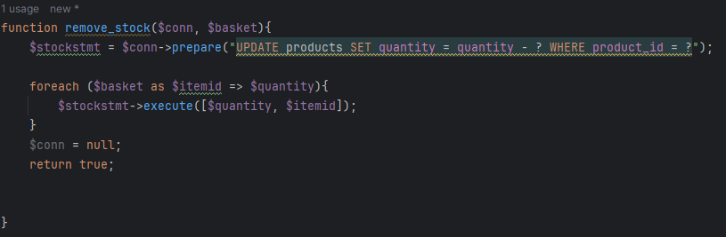
Test no. 3.1 Remove stock Test
In the end, I had formatted the function incorrectly. It needed to be as shown above, not like how it is on page 12. The function now goes through each item that has been ordered and removes the quantity from the quantity available.
13.

Slide 14


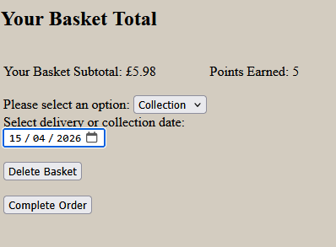

Test no. 3.2 Loyalty Scheme Test
For Adding points on purchase. The system stores points in session based on the basket subtotal so 1 point every £1 spent which would be redeemed at checkout. Add points function worked as intended. Updating a users points when they make a purchase.
14.

Slide 15
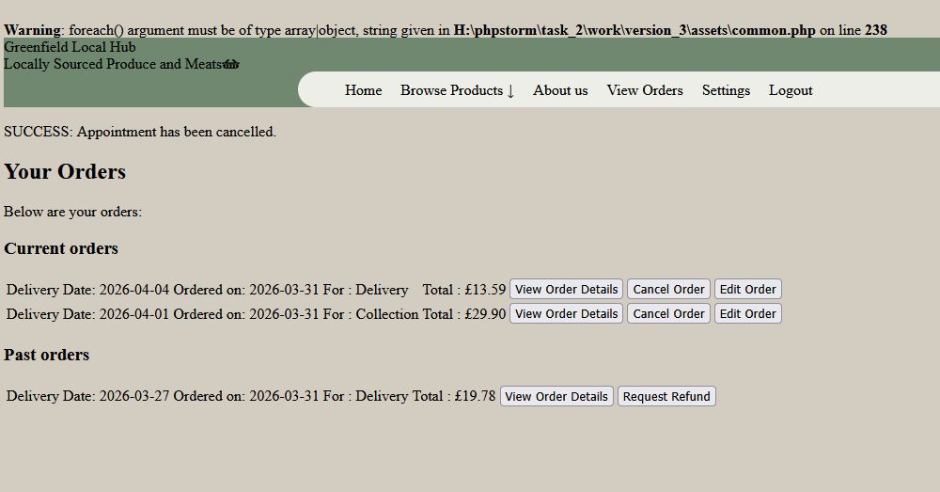
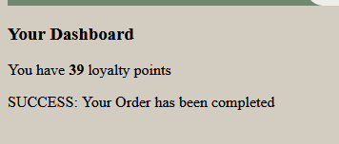
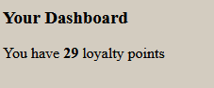
Test no. 3.3 Cancelling Orders Test
The loyalty points were updated but the order wasn’t actually cancelled. See 16 for solution
15.

Slide 16
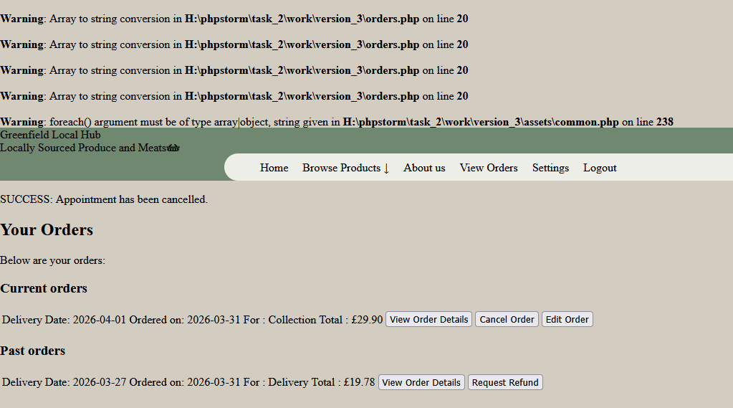
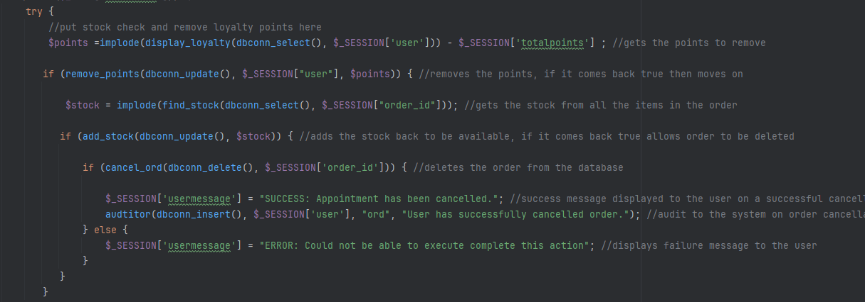
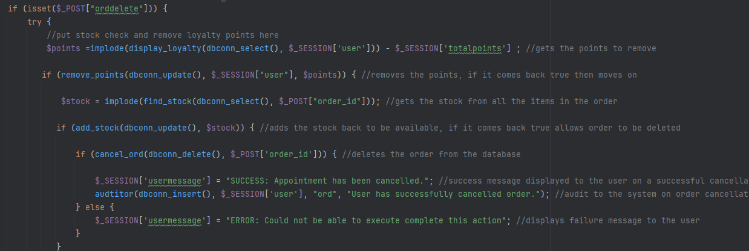
Test no. 3.3 Cancelling Orders Test
To fix the issue and allow orders to be cancelled, I had to change from getting the order_id through session (causing truancy in the array) to getting them through post.
16.

Slide 17
Version 4 Tests
Planned development:
4.1 Staff Login System
4.2 Registering Staff Accounts
4.3 Updating Product Quantities
4.4 Adding New Products
17.

Slide 18
Test no. 4.2.1 Registering to the system
To start my testing, I need to start on the register system so that an account can be created to test the system login.
The initial test showed the error below:
This means there is likely an issue with the values in my sql statement (forgot to update when pulling from the customer side)
As shown above, There is only 3 ? in values when there needs to be 4.
This will be updated, as well as checking other statements to ensure the values are all up to date.
18.

Slide 19
Test no. 4.2.2 Registering to the system
After the parameter issue was resolved, I retested and got another error message:
Originally, I wasn’t quite sure what was causing this error but after checking my database. I discovered that an account has successfully been made. This means the error is likely being caused by the audit system.
Instead of fixing this issue now, I will be fixing it after the login system works as only admins will be able to register new accounts so the audit should have their accounts id not the registered account. I will be moving onto the login system since a staff account now exists with a properly hashed password.
19.

Slide 20
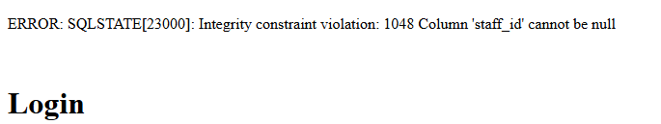

Test no. 4.1.3 Login system
During the initial test of the login system, I got the same error I received with the register system.
This proves that the issue with the audit system is more severe then before and needs looking at now rather then later.
Whilst investigating, I discovered this. I changed ‘user_id’ to ‘staff_id’ and it worked as intended with an audit being logged to the system.
20.

Slide 21

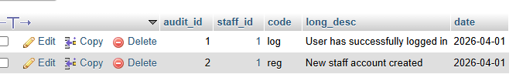
Test no. 4.2.4 Register system
Thankfully During the test on the register system after fixing login, It worked as intended with an account being successfully made with the audit recording the admin account that made it (staff_id = 1) and not the account that was just made
21.

Slide 22

Test no. 4.5.5 Logout system
A system I failed to plan for was a users ability to log out of their account. Another oversight on my part. I was originally going to use the same login that the regular users use to reduce code repeatability but that was not the most secure option as I want to keep the staff and user common and system completely separate so I chose to repeat the code to accomplish that and to ensure the audits were sent to the correct table and users were sent to the correct pages.
On logout, The audit was made successfully but no message was displayed to the user confirming the logout.
After investigating, I discovered that the login page did not have the correct message display code for when users aren’t logged in so it didn’t display. It has now been corrected.
22.

Slide 23
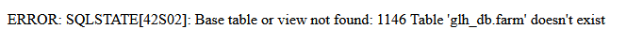
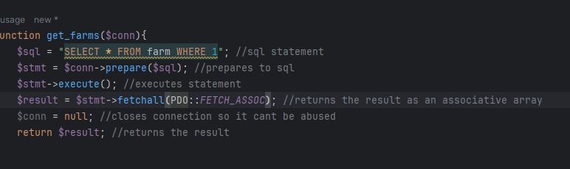
Test no. 4.4.6 Adding new products
Whilst testing my get farms function, to display the farms stored in the database the farms weren’t displaying and I got the following error
This was caused by forgetting an s in the sql statement.
This has now been fixed.
23.

Slide 24

Test no. 4.4.6 Adding new products
During my first test, an error message showed an issue with the image alt tag. It wasn’t sending to the database. I checked to make sure the naming conventions were right and they weren’t after this was fixed the code ran as expected with data being added to the database successfully.
One thing I did not think about was actually getting the image stored in the correct file so as future development, I would devleop a drag and drop to drop the image file in and send to the assets folder.
24.

